Slide 1
Mining Compressed Frequent-Pattern Sets
Dong Xin, Jiawei Han, Xifeng Yan, Hong Cheng
Department of Computer Science
University of Illinois at Urbana-Champaign

Slide 2
Outline
Introduction
Problem Statement and Analysis
Discovering Representative Patterns
Performance Study
Discussion and Conclusions

Slide 3
Introduction
Frequent Pattern Mining
  Minimum Support: 2
(b) : 3
(a) : 2
(a, b) : 2
(a, d) : 2
(d) : 2
(b, d) : 2
(e) : 2
(b, e) : 2
(a, b, d) : 2
(a, b, c, d)
(a, b, d, e)
(b, e, f)

Slide 4
Challenge In Frequent Pattern Mining
Efficiency?
  Many scaleable mining algorithms are available now
Usability?—Yes
  High minimum support: common sense patterns
  Low minimum support: explosive number of results

Slide 5
Existing Compressing Techniques
Lossless compression
  Closed frequent patterns
  Non-derivable frequent item-sets
  ...
Lossy approximation
  Maximal frequent patterns
  Boundary cover sets
  …

Slide 6
A Motivating Example
A subset of frequent item-sets in accident dataset
High-quality compression needs to consider both expression and support
ID | Item-Sets | Support
P1 | {38,16,18,12} | 205227
P2 | {38,16,18,12,17} | 205211
P3 | {39,38,16,18,12,17} | 101758
P4 | {39,16,18,12,17} | 161563
P5 | {39,16,18,12} | 161576
Expression of P1
Support of P1

Slide 7
A Motivating Example
Closed frequent pattern
  Report P1,P2,P3,P4,P5
  Emphasize too much on support
  no compression
Maximal frequent pattern
  Only report P3
  Only care about the expression
  Loss the information of support
A desirable output: P2,P3,P4
ID | Item-Sets | Support
P1 | {38,16,18,12} | 205227
P2 | {38,16,18,12,17} | 205211
P3 | {39,38,16,18,12,17} | 101758
P4 | {39,16,18,12,17} | 161563
P5 | {39,16,18,12} | 161576

Slide 8
Compressing Frequent Patterns
Our compressing framework
  Clustering frequent patterns by pattern similarity
  Pick a representative pattern for each cluster
Key Problems
  Need a distance function to measure the similarity between patterns
  The quality of the clustering needs to be controllable
  The representative pattern should be able to describe both expressions and supports of other patterns
  Efficiency is always desirable

Slide 9

Distance Measure
Let P1 and P2 are two closed frequent patterns, T(P) is the set of raw data which contains P, the distance between P1 and P2 is:
Let T(P1)={t1,t2,t3,t4,t5}, T(P2)={t1,t2,t3,t4,t6}, then D(P1,P2)=1-4/6=1/3
D is a valid distance metric
D characterizes the support, but ignore the expression

Slide 10
Representative Patterns
Incorporate expression into Representative Pattern
  The representative pattern should be able to express all the other patterns in the same cluster (i.e., superset)
  The representative pattern Pr: {38,16,18,12,17}
Representative pattern is also good w.r.t. distance
  D(Pr, P1) ≤ D(P1, P2), D(Pr, P1) ≤ D(P1, P2)
  Distance can be computed using support only
ID | Item-Sets | Support
P1 | {38,16,18,12} | 205227
P2 | {38,16,18,17} | 205310

Slide 11
Clustering Criterion
General clustering approach (i.e., k-means):
  Directly apply the distance measure
  No guarantee on the quality of the clusters
  The representative pattern may not exist in a cluster
δ-clustering
  For each pattern P, Find all patterns which can be expressed by P and their distance to P are within δ (δ-cover)
  All patterns in the cluster can be represented by P

Slide 12
Intuitions of δ-clustering
All Patterns in the cluster are supported by almost same set of transactions
  Distance from any pattern to representative is bounded by δ
  Distance between any two patterns is bounded by 2 *δ
  The small difference between transaction sets could be noise or negligible
Representative Pattern has the most informative expression

Slide 13
Pattern Compressing Problem
Pattern Compression Problem
  Find the minimum number of clusters (representative patterns)
  All the frequent patterns are δ-covered by at least one representative pattern
  Variation: support of representative pattern less than min_sup?
NP-hardness: Reducible from set-covering problem
Pattern Compression | Set-Covering
Frequent Patterns | Elements
Representative patterns | Sets
Minimize number of representative patterns | Minimize number of covering set

Slide 14
Discovering Representative Patterns
RPglobal
  Assume all the frequent patterns are mined
  Directly apply greedy set-covering algorithm
  Guaranteed bounds w.r.t. optimal solution
RPlocal
  Relax the constraints used in RPglobal
  Gain in efficiency, lose in bound guarantee
  Directly mine from raw data set
RPcombine
  Combine above two methods
  Trade-off w.r.t. efficiency and performance

Slide 15
RPglobal
Algorithm
  At each step, find the representative pattern Pr which δ-covers the maximum number of uncovered patterns
  Select Pr as new representative pattern
  Mark the corresponding pattern as covered
  Continue until all patterns are covered
Bound:
  |Cg| (|C*|) is the number of output of RPglobal (optimal)
  F is the set of frequent patterns
  Set(P): set of the patterns covered by P

Slide 16
RPlocal
RPglobal is expensive
  Assume all the frequent pattern are pre-computed
  Need to find the globally best representative pattern at each step
  Need to compute the pair-wise distance between all frequent patterns
Relax the constraints: RPlocal
  Find a locally good representative pattern each step
  Directly mine from raw data
  Do not compute the distance pair-wisely

Slide 17
Local Greedy Method
Principle of Local Method
Bound
  |Cl|: number of output using local method
  T: optimal number of patterns covering all probe patterns
  Set(P): set of the patterns covered by P
Global Greedy | Local Greedy
Find each pattern Pr (not covered) | Probe pattern P (not covered)
Find all patterns covered by Pr | Find all patterns Pr covering P
Select Pr with largest coverage | Select Pr with largest coverage and covering P

Slide 18
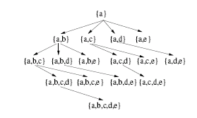
Mine from Raw Data
Beneficial
  Without storage of huge intermediate outputs
  More efficient pruning methods
Applicable
  Utilize the internal relations during mining
  FP-growth method
    Depth first search in Pattern-Space
    A pattern can only be covered by its sons or patterns visited before
Probe Pattern P
P’s Sons
Visited Patterns covering P

Slide 19
Integrate Local Method into FP-Mining
Algorithm
  Follow the depth-first search in pattern space
  Remember all previously discovered representative patterns
  For each pattern P
    Not covered yet
    Being Visited in the second time which traversal back from its sons
  Select a representative pattern using local method (with P as new probe pattern)

Slide 20
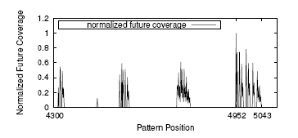
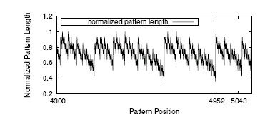
Avoid Pair-wise Comparisons
Find a good representative pattern (for probe pattern P)
  Strong correlations between Pattern positions, coverage of uncovered patterns and pattern length
  Simple but effective heuristic: select the longest item-sets in P’s sons as a new representative pattern to cover P
    4952: first visit of P, 5043: second visit of P (between 4952 and 5043 are sons of P)
Previous Patterns
First time visit of P
second time visit of P
P’s Sons

Slide 21
Efficient Implementation
Non Closed Pattern
  Exist a super pattern with same support
Closed_Index (N bits)
  Each bit remembers the consistency of an item
  Aggregate the closed_index with pattern
  Not closed if at least one out-pattern bit is set
Transaction | Closed_index
(f,c,a,m,p) | 111011
(f,c,a,b,m) | 111110
(f,b) | 100100
(f,c,a,m,p) | 111011
(c,a) 111010
f does not belong to (c,a). Support of (c,a) is same as support of (f,c,a). (c,a) is not closed

Slide 22
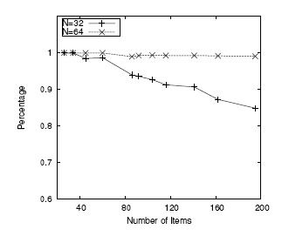
Efficient Implementation
Prune non-closed patterns
  Non-closed patterns are guaranteed to be covered
  Use limited bits to remember subset of items
  Majority non-closed patterns are pruned by closed_index
  A few left are pruned by checking the coverage of representative patterns

Slide 23
Experimental Setting
Data
  frequent itemset mining dataset repository (http://mi.cs.helsinki./data/)
Comparing algorithms
  FPclose: an efficient algorithm to generate all closed itemsets, winner of FIMI workshop 2003
  RPglobal: first use FPclose to generate closed itemsets, then use global greedy method to find representative patterns
  RPlocal: directly use local method to find representative patterns from raw data

Slide 24
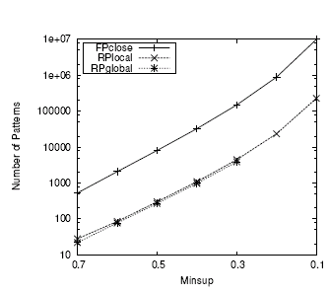
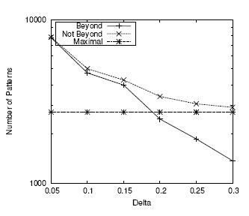
Performance Study
Number of Representative Patterns
Notes:
Left graph: delta=0.1, the short one is the result of rpglobal, the longer one is the result of rplocal. The result of rpglobal is partial because for small minsup, there are huge number of closed patterns, RPglobal does not scale well.
This is connect dataset.
Right graph: beyond case means we allow the support of representative patterns to be less than minsup (but still with delta bound)

Slide 25
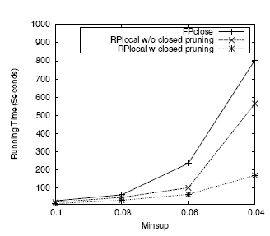
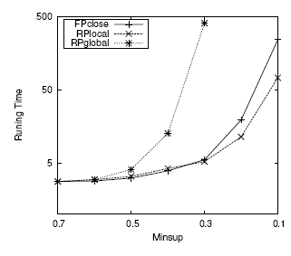
Performance Study
Running Time
Notes:
Left graph: delta=0.1, corresponding to previous graph.
Right graph: even w/o closed pruning, rplocal is more efficient, because number of representative patterns is much less than number of closed patterns, to cost to maintain the output tree to check the closeness is higher than the cost to maintain the output tree of representative patterns

Slide 26
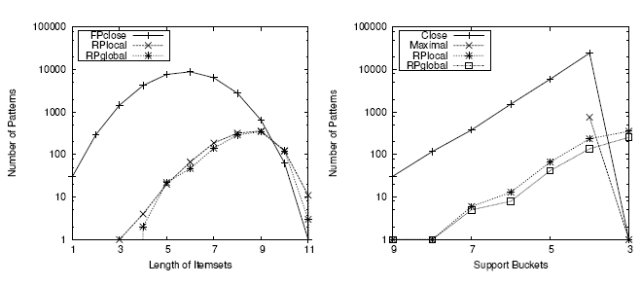
Performance Study
Quality of Representative Patterns

Slide 27
Conclusions
Significant reduction of the number of output
  Two orders of magnitudes of reduction for δ= 0.1
  Catch both expressions and supports
  Easily extendable for compression of sequential, graph and structure data
RPglobal
  theoretical bound
  works well on small collection of patterns
RPlocal
  much more efficient
  Still quite good compression quality

Slide 28
Future Work
Using representative patterns for association, correlation and classification
Compressing frequent patterns over incrementally updated data (i.e., stream)
Further compressing the representative patterns by some advanced compression models (i.e., pattern profiles)

